Slide 1
PyCBC basics
LIU Yuting
Somiya Lab. Tokyo Institute of Technology

Slide 2
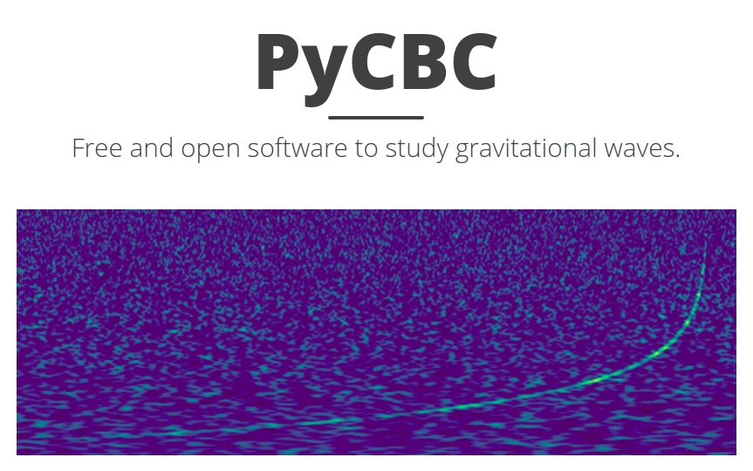
What is PyCBC?
A software package used to explore astrophysical sources of gravitational waves.
Contains algorithms that can detect coalescing compact binaries (CBC) and measure the astrophysical parameters of detected sources.
Used in the first direct detection of gravitational waves (GW150914) by LIGO and is used in the ongoing analysis of LIGO and Virgo data.

Slide 3
Who can use PyCBC?
PyCBC is a open source and free software. Not only LIGO and Virgo, everyone can access PyCBC document and install it on their own computer.
If you use PyCBC in your publications or projects, you must cite the publications that describe PyCBC.
Beginners need to handle only basic coding knowledge. No need to write every code yourself.
How to install PyCBC?
For Windows system, PyCBC has to be installed under Docker.
For Mac and Linux system, you can choose installing PyCBC under Docker, or install it directly(recommend).
PyCBC supports Python2 only. I recommend to install Anaconda to manage the package versions.

Slide 4
What can PyCBC do?
Waveforms generation
PyCBC can generate gravitational waves in Time domain or Frequency domain.
Noise generation
Simulate the noise in detectors based on sensitivity PSD.
Matched filtering
Currently, LIGO and Virgo mainly use PyCBC to detect CBC events having a signal-to-noise ratio (SNR) higher than the threshold.
Detector information
Including detector positions, antenna patterns, and the others.
Event catalog
Provides observed merger events information: time, amplitude, frequency......
......

Slide 5
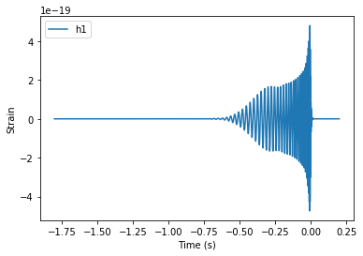
Waveforms generation*
Parameters:
mass1, mass2
spin1x, spin1y, spin1z
spin2x, spin2y, spin2z
eccentricity
lambda1, lambda2 (tidal deformability)
distance (default = 1Mpc)
coa_phase (coalescence phase)
inclination
delta_t (sample time step)
approximant
f_lower (high pass filter)
......
pycbc.waveform.get_td_waveform( 'Parameters' )
*: Detail explanation can be found in the ipynb file

Slide 6
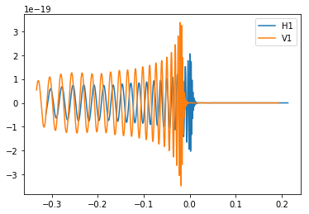
Response of Detectors*
Detected data of the detectors are depending on not only the waveforms, but also detectors characteristics.
pycbc.detector.Detector.project_wave('Parameters')
Parameters:
hp, hc (two polarizations of GW)
right_ascension, declination (GW source direction)
polarization (polarization phase for the merger)

Slide 7
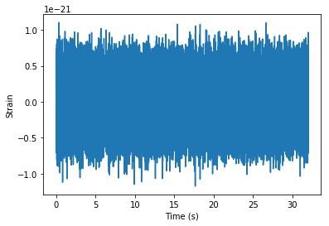
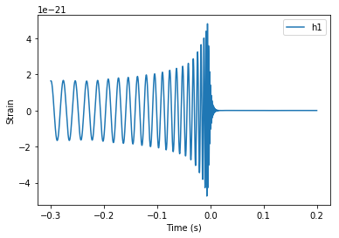
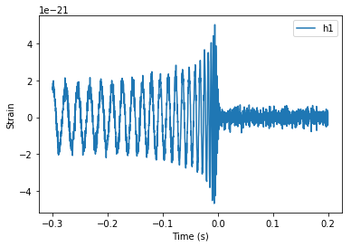
Noise generation*
pycbc.noise.noise_from_psd('parameters')
Parameters:
length(duration)
delta_t (time step)
psd (noise weighting to color the noise)
seed (randomization)

Slide 8
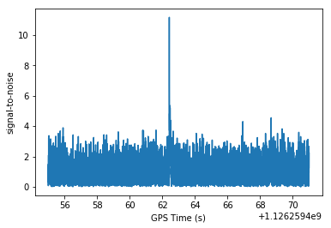
Matched filtering
snr = pycbc.filter.matchedfilter.matched_filter('Parameters')
Parameters:
templates (template waveform)
data (strain data to be filtered)
psd (noise weighting of the filter)
low_frequency_cutoff
high_frequency_cutoff

Slide 9
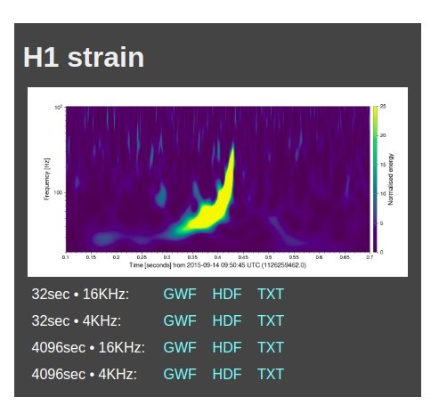
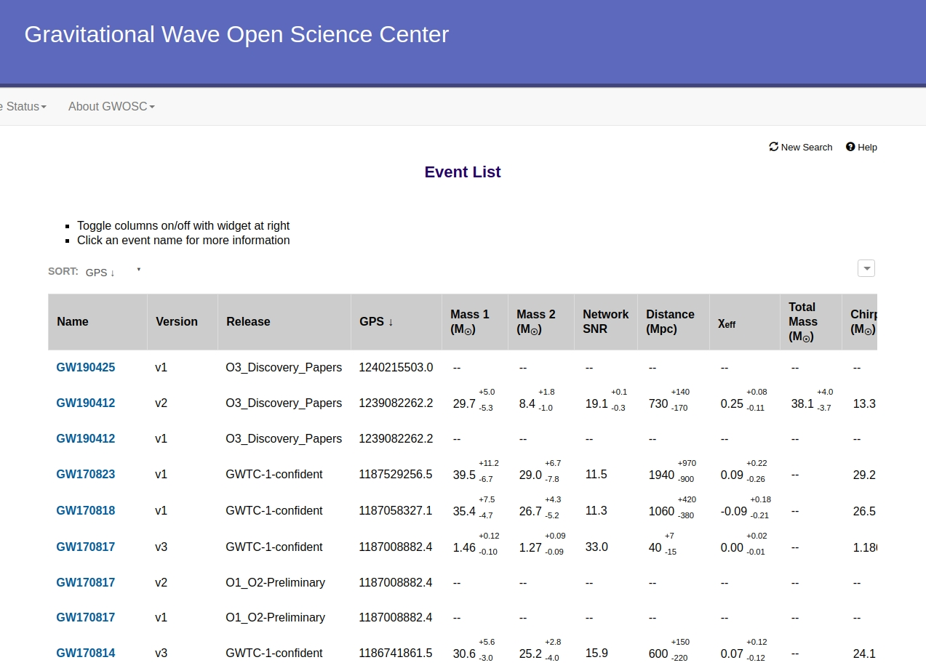
Matched filtering -- Raw data obtain*
Data file URL

Slide 10
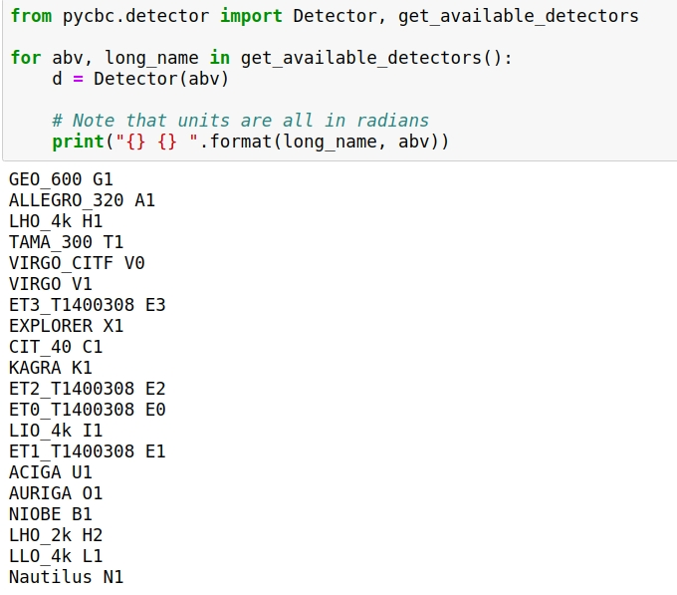
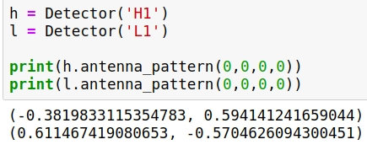
Detectors

Slide 11
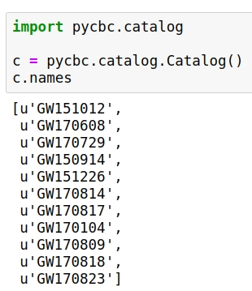
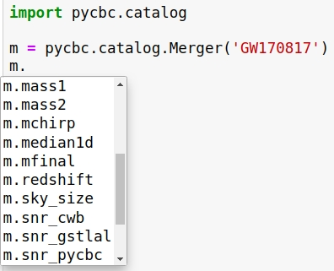
GW events*
PyCBC catalog package contains some merger events.
We can use this package to read the details of the events.

Slide 12
Application examples
Estimate the GW amplitude from a hand shake
Measure the earth radius
Hubble constant measurement
Use matched filtering to estimate masses

Slide 13

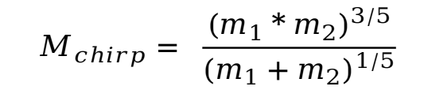

Example 1: GW amplitude from a handshake*
Here we estimate the gravitational wave estimated from a handshake.
Assume the hands have equal mass = 0.3kg, and the observe point is your body, where is 1meter away from the hands.
Use PyCBC to simulate this hand shake. Because the minimum mass of PyCBC algorithm is 1 M☉, so firstly we make a liner equation of Chirp Mass and Amplitude.
After we get the liner function, calculate the estimated GW amplitude, then compare the result with a theoretical value.
$$M_{chirp}= \frac{{(m_{1}*m_{2})}^{3/5}}{{(m_{1}+m_{2})}^{1/5}}$$
$$h∝ M_{chirp}^{5/3}$$

Slide 14
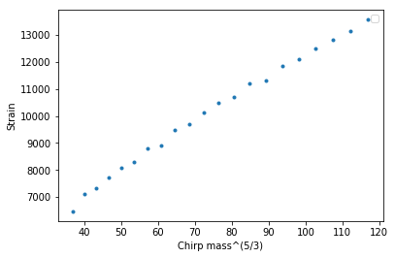
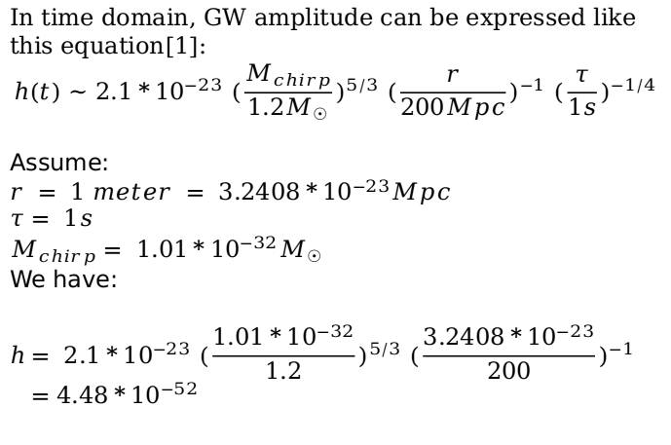

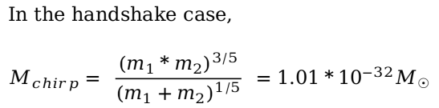

Example 1: GW amplitude from a handshake
PyCBC algorithm
Theoretical approximate equation
$$h= 83.3 {M_{chirp}}_{ }^{5/3}$$
In time domain, GW amplitude can be expressed like this equation[1]:
$$h(t) \sim 2.1*{10}^{−23}{ (\frac{M_{chirp}}{{1.2M}_{☉}})}^{5/3} {(\frac{r}{200Mpc})}^{−1}{ (\frac{τ}{1s})}^{−1/4}$$
Assume:
$$r = 1 meter = 3.2408*{10}^{−23}Mpc$$
$$τ= 1s$$
$$M_{chirp}= 1.01*{10}^{−32}M_{☉}$$
We have:
$$h= 2.1*{10}^{−23}{ (\frac{1.01*{10}^{−32}}{1.2})}^{5/3} {(\frac{3.2408*{10}^{−23}}{200})}^{−1}$$ $=4.48*{10}^{−52}$
In the handshake case,
$$M_{chirp}= \frac{{(m_{1}*m_{2})}^{3/5}}{{(m_{1}+m_{2})}^{1/5}} =1.01*{10}^{−32}M_{☉}$$
$$h= 3.93*{10}^{−52}$$
[1] Yoshinori Fujii, Fast localization of coalescing binaries with gravitational wave detectors and low frequency vibration isolation for KAGRA, 2020

Slide 15

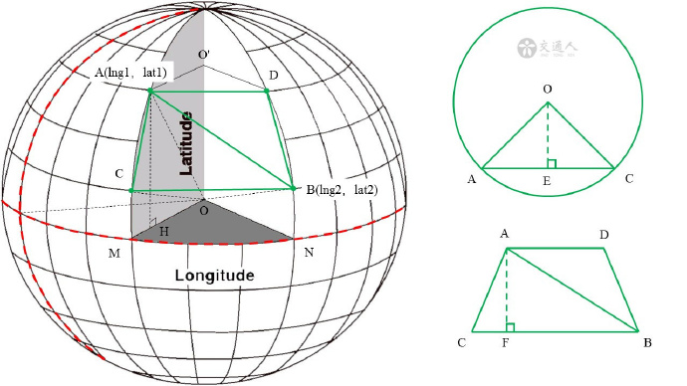
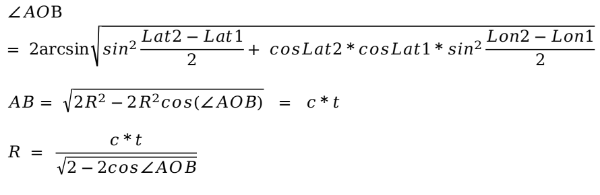

Example 2: Measure the earth radius*
Use PyCBC to measure the earth radius.
Read the position of the detectors (Latitudes and Longitudes)
Calculate the direct distance between the detectors $AB$
Read the direct GW traveling time between the detectors $t$
$$∠AOB= 2arcsin\sqrt{\sin^{2}\frac{Lat2−Lat1}{2}+ cosLat2*cosLat1*\sin^{2}\frac{Lon2−Lon1}{2}}$$
$$AB= \sqrt{2R^{2}−2R^{2}cos(∠AOB)} = c*t$$
$$R = \frac{c*t}{\sqrt{2−2cos∠AOB}}$$

Slide 16
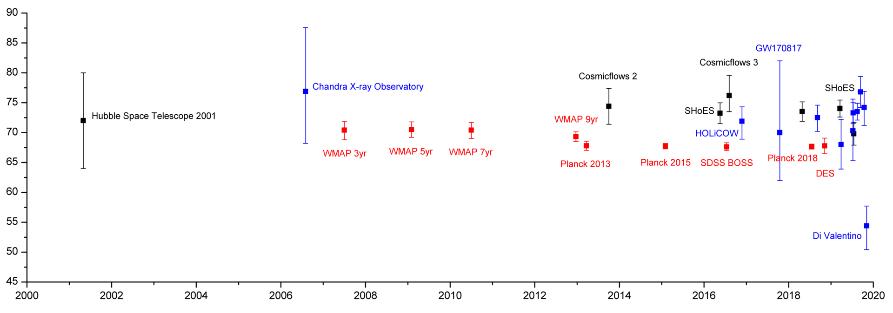

Example 3: Hubble constant measurement
Hubble's law: The galaxy is moving away from the earth, and the further they are the the faster they move.
Their velocity can be expressed by $v = H_{0}D$, where $H_{0}$ is the Hubble constant, and $D$ is the distance.
Estimated values of the Hubble constant

Slide 17
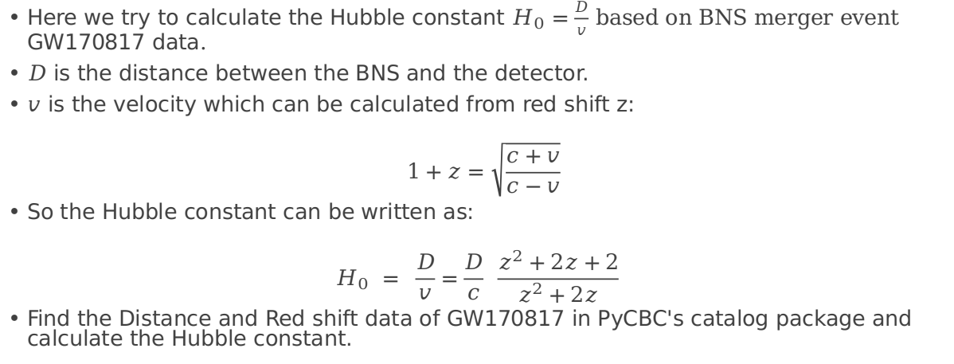
Example 3: Hubble constant measurement*
Here we try to calculate the Hubble constant $H_{0}=\frac{D}{v}$ based on BNS merger event GW170817 data.
$D$ is the distance between the BNS and the detector.
$v$ is the velocity which can be calculated from red shift z:
$$1+z=\sqrt{\frac{c+v}{c−v}}$$
So the Hubble constant can be written as:
$$H_{0} = \frac{D}{v}=\frac{D}{c} \frac{z^{2}+2z+2}{z^{2}+2z}$$
Find the Distance and Red shift data of GW170817 in PyCBC's catalog package and calculate the Hubble constant.

Slide 18
Example 4: Use matched filtering to estimate masses*
Generate template waveform using PyCBC.
Matched filtering compares detected signal with template waveforms, and gives SNRs. The higher the SNR is, the more similar they are.
We believe a template having a maximum SNR is corresponding to the real GW wave. In this way, detected GW parameters can be estimated.
(NO 'SPACE' IN THE FOLDER NAME!)

Slide 19
Problems:
Optional topics for freshmen, you can also consider trying.
Install PyCBC and generate a waveform.
How does the waveform change with the distance of the binary?
How does the waveform change with the masses of the binary?
Use GW150914 data to estimate the Hubble constant.
Try to estimate the black hole masses of GW150914. Compare your result with LIGO's data.
Get the position and light raveling time of LIGO Handford and Virgo, estimate the earth radius. Compare your result with the LIGO Livingston -- LIGO Hanford result.
NGC 6240 is an ultraluminous infrared galaxy where is 102 Mpc far from earth. Researchers believe that in the centre of NGC 6240, two supermassive black holes are merging. Each of the supermassive black holes has over 90 million times the mass of the Sun. If the two supermassive black holes merge, how strong GW can we detect? (Use the function of handshake simulation, and consider the distance.)

Slide 20
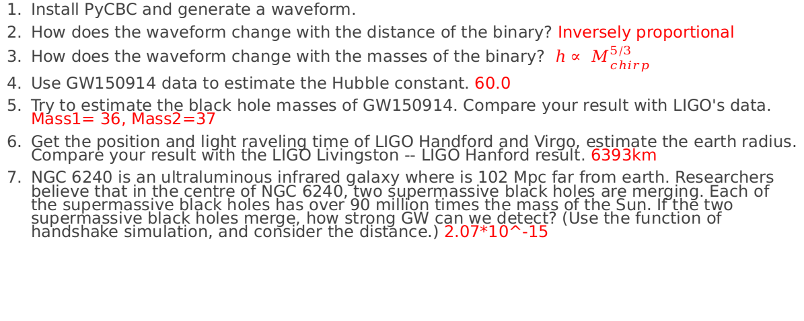
Problems:
Optional topics for freshmen, you can also consider trying.
Install PyCBC and generate a waveform.
How does the waveform change with the distance of the binary? Inversely proportional
How does the waveform change with the masses of the binary? $h∝ M_{chirp}^{5/3}$
Use GW150914 data to estimate the Hubble constant. 60.0
Try to estimate the black hole masses of GW150914. Compare your result with LIGO's data. Mass1= 36, Mass2=37
Get the position and light raveling time of LIGO Handford and Virgo, estimate the earth radius. Compare your result with the LIGO Livingston -- LIGO Hanford result. 6393km
NGC 6240 is an ultraluminous infrared galaxy where is 102 Mpc far from earth. Researchers believe that in the centre of NGC 6240, two supermassive black holes are merging. Each of the supermassive black holes has over 90 million times the mass of the Sun. If the two supermassive black holes merge, how strong GW can we detect? (Use the function of handshake simulation, and consider the distance.) 2.07*10^-15

Slide 21
Appendix
PyCBC document: http://pycbc.org/pycbc/latest/html/
LIGO-Virgo data center: https://www.gw-openscience.org/eventapi/html/allevents/
Python tutorial: https://cs231n.github.io/python-numpy-tutorial/#lists
Source code: https://github.com/liuyutin/PyCBC-basics.git

